Slide 1
DOE/NNSA Pantex Plant Superfund Site
Site Background
Camille Hueni, EPA Region 6

Slide 2
DOE/NNSA Pantex Plant Superfund Site
Active National Nuclear Security Administration Site, 17 miles northeast of Amarillo, TX;
Listed on the National Priorities List in 1994;
Sitewide ROD signed in 2008;
Construction Completion achieved in 2009;
Ongoing remedial actions target restoration of the Perched Aquifer to protect the underlying Ogallala;
The Pantex Renewable Energy Project (PREP) and completion of the Superfund remedial action phase proceeded on parallel, but independent tracks.
2

Slide 3
3

Slide 4



Wind Energy
Kevin Long, Facilities & Infrastructure Modernization
Consolidated Nuclear Security, LLC
NNSA Pantex Plant, Amarillo, Texas

Slide 5
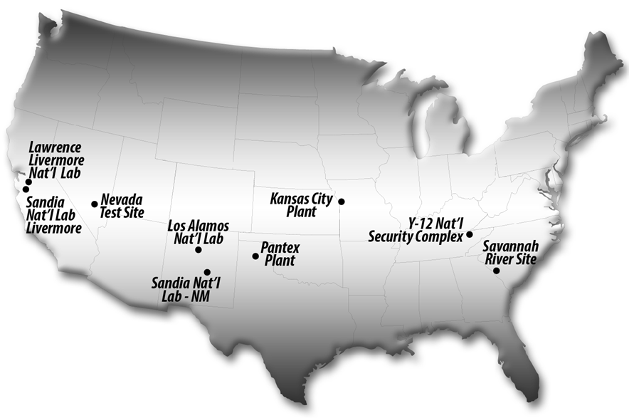
National Nuclear Security Administration (NNSA)
Established by Congress in 2000, NNSA is a semi-autonomous agency within the U.S. Department of Energy responsible for enhancing national security through the military application of nuclear science. NNSA maintains and enhances the safety, security, reliability and performance of the U.S. nuclear weapons stockpile without nuclear testing; works to reduce global danger from weapons of mass destruction; provides the U.S. Navy with safe and effective nuclear propulsion; and responds to nuclear and radiological emergencies in the U.S. and abroad.
Maintaining the Stockpile
Nonproliferation
Powering the Nuclear Navy
Emergency response
Oversight and change
Counterterrorism
5

Slide 6
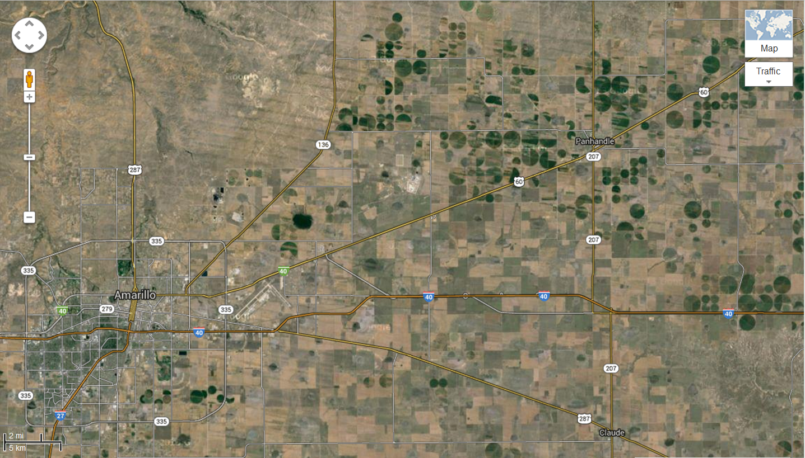
Pantex Plant Location
6

Slide 7
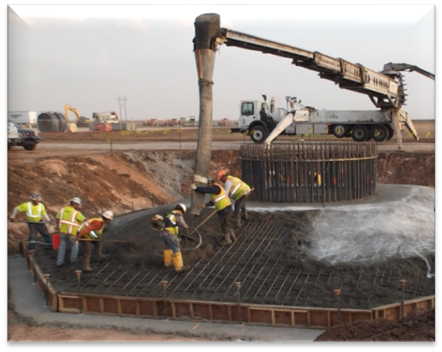
Objectives
Satisfy Presidential Objectives for US Government Energy Usage:
  Executive Order 13423 - Strengthening Federal Environmental, Energy and Transportation Management
    Improve energy efficiency and reduce greenhouse gas emissions
    Implement renewable energy generation projects on agency property for agency use
  Executive Order 13514 – Federal Leadership in
  Environmental, Energy, and Economic Performance
    Reduce energy intensity in agency buildings
    Increase agency use of renewable energy
  DOE Strategic Sustainability Performance Plan
    Includes the President’s goal for use of 20%
    renewables by the year 2020
7

Slide 8
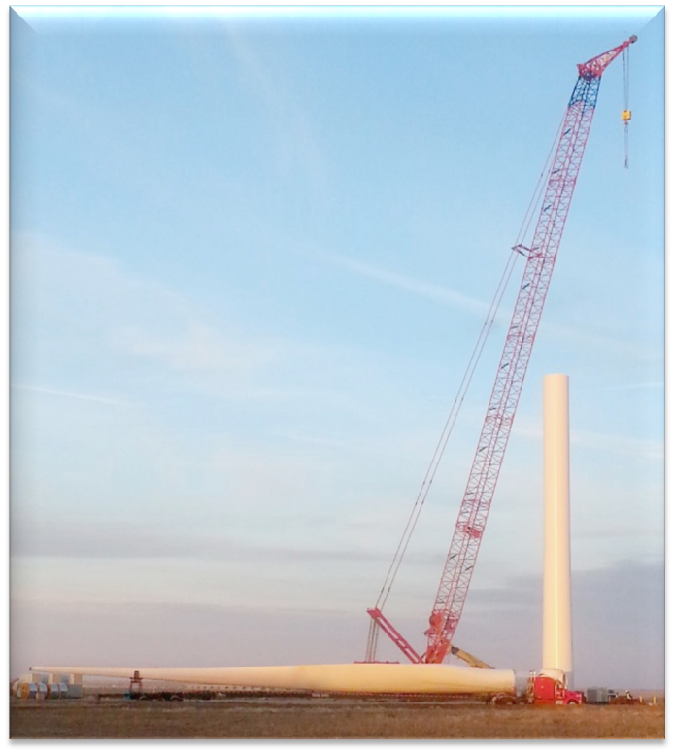
Specifics
Five 2.3 MW Siemens Wind Turbines located on 1,500 Acres of USG land in a Class IV wind corridor
  Towers are approximately 243 ft. tall
  Blade diameter is approximately 331 ft.
  Blade tip at top of rotation is 408 ft. above ground level
  Each of the five turbine foundations has 325 cubic yards of concrete
  Blade tip moves at speeds on the order of 130 mph (depending on wind speed)
8

Slide 9
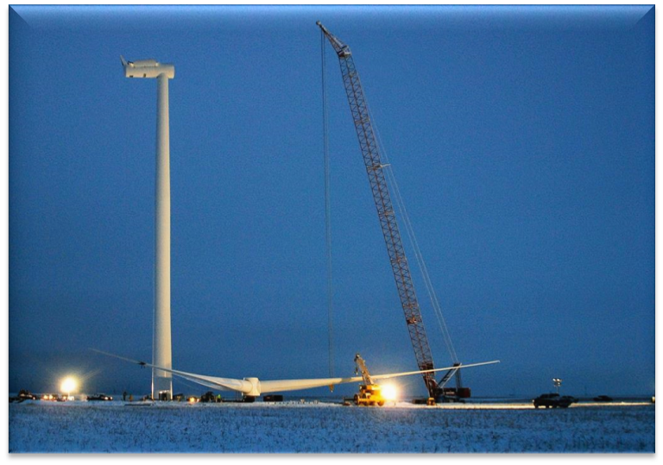
Specifics (cont’d)
Wind farm will be connected to Pantex Plant for direct feed of electrical need with ability to shed surplus power to the local utility grid
Generate 47 million kilowatt hours of electricity annually
Projected to meet up to 60% of the Plant’s electrical demand needs
Estimated to eliminate over 534,000 metric tons of CO2 GHG over system life
Built under an Energy Savings Performance Contract (ESPC)
Will generate 47,000 renewable energy credits annually (shared w/Y-12)
9

Slide 10
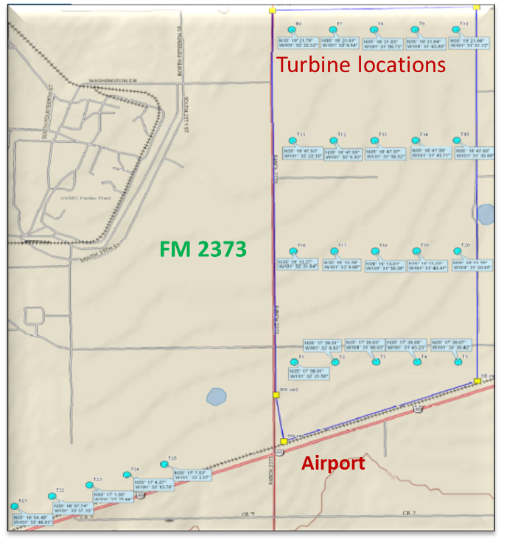
Project Approval Requirements
  Federal Aviation Administration (FAA)
    Approval required for any object over 200 feet above ground level
    Approval also required based on Pantex location to the Amarillo International Airport (within 10 nautical miles of the runway)
    Initial submission of Notice of Proposed Construction (Form 7460-1) to FAA requires location information for each Wind Turbine Generator (WTG):
    Latitude
    Longitude
    Height
    Submission of Supplemental Notice of Actual Construction (Form 7460-2 Part I) to FAA required at a minimum of 10 days prior to construction
    Submission of Supplemental Notice of maximum height (Form 7460-2 Part II) to FAA Required at a minimum of five days of turbine reaching maximum height
10

Slide 11
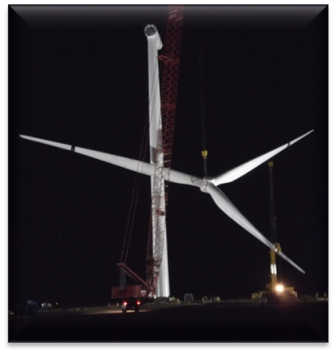
Project Approval Requirements (cont’d)
Qualifying Facility (QF) Application
  Required by Federal Energy Regulation Commission (FERC) (18 CFR 131.80) to allow independent facilities to produce up to 15MW of electrical power and requires the utility to purchase generation from Pantex
Southwest Power Pool (SPP) Application
  SPP regulates power generators and authorizes tie-in to existing electrical grid for entities seeking to place power on the grid
  SPP performs an Interconnection Feasibility Study and Facilities Study
  SPP sends Generation Interconnection Agreement to be executed by the parties involved (Pantex, SPP, and Xcel), allows power onto the grid
  Power can also be transferred to the Continuous Renewable Energy Zone (CREZ) system via Xcel grid
11

Slide 12
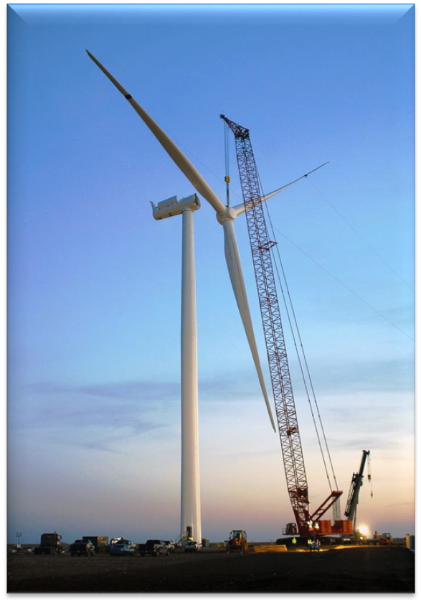
Project Details
NNSA Albuquerque Office Contract Administrator
  Energy Saving Performance Contract (ESPC) use for the procurement of the WTG
  ESPC Proposals evaluated by the subject matter experts for the project
  Siemens Energy selected and the ESPC Contractor:
    Provided turnkey installation of WTGs
    Connected to the Pantex Electrical South Substation
    Constructed a parts and maintenance building
    Term of the ESPC is 18 year payment
  Albuquerque Office negotiated billing agreement with local utility (Xcel) to allow net billing on energy used vs excess
12

Slide 13
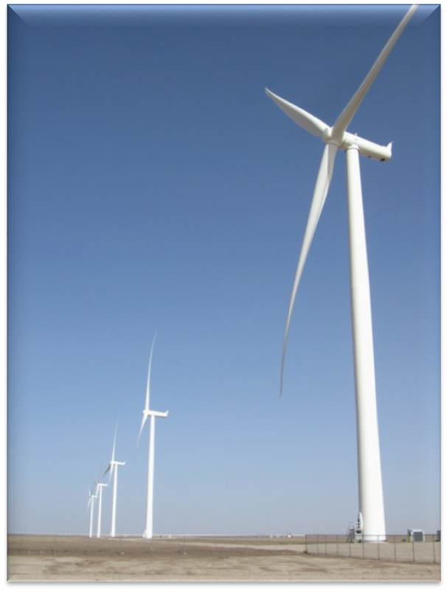
Partnerships
National Renewable Energy Laboratory (NREL)
  Technical consulting to NNSA, NPO, and Pantex
    Statement of Work, Request for Proposal and Proposal Evaluation
    Liaison to FAA for approvals and reviews
Idaho National Laboratory (INEL)
  Technical consulting to NPO and Pantex
    Regulatory issues
    System design
13

Slide 14
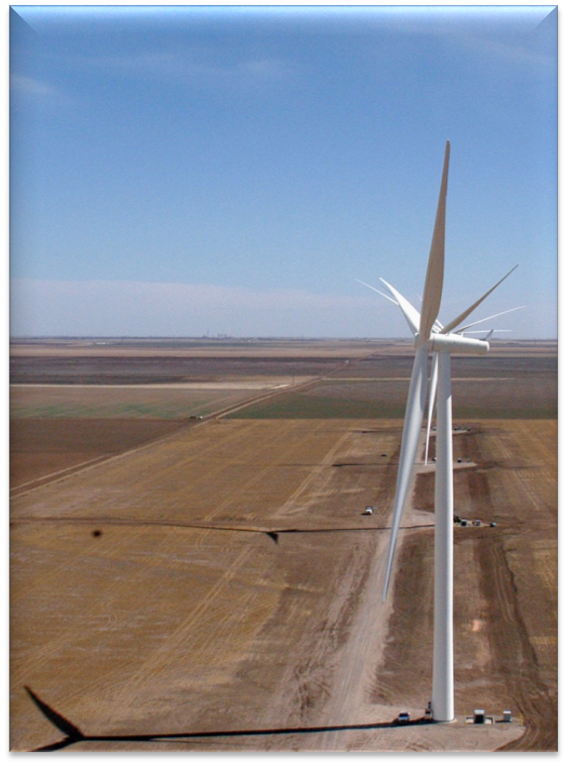
Partnerships (cont’d)
Research and Development Collaboration
  Texas Tech University - NNSA has a Memorandum of Understanding (MOU) with the Texas Tech University (TTU). Throughout the wind farm life, the TTU may propose, through its relationship with NNSA, to use the Pantex wind farm for TTU research sponsored activities with its collaborators. Potential activities include:
      Data Collection and Analysis – All raw data collected as part of the manufacture/developers data collection systems associated to the wind farm will be made available to the TTU
      Optimization Research and New Technology Development - Perform various operational test and performance evaluations to investigate improving system production
      Critical Skills – Collaboration with TTU to expand a range of talent that aligns with the Pantex mission, science, engineering, high explosives, etc.
14

Slide 15
For More Information, Contact:
For inquiries about the wind energy project at the NNSA Pantex Plant:
Kevin Long
Consolidated Nuclear Security, LLC
NNSA Pantex Plant, Amarillo, Texas
(806) 477-3308
klong@pantex.com
For inquiries about the DOE/NNSA Pantex Plant Superfund site:
For inquiries about the EPA Region 6 Greenovations Award:
Casey Luckett Snyder
EPA Region 6
(214) 665-7393
luckett.casey@epa.gov
Camille Hueni
EPA Region 6
(214) 665-2231
hueni.camille@epa.gov
Tony Biggs
Consolidated Nuclear Security, LLC
NNSA Pantex Plant, Amarillo, Texas
(806) 477-3203
tony.biggs@cns.doe.gov
15

